Slide 1
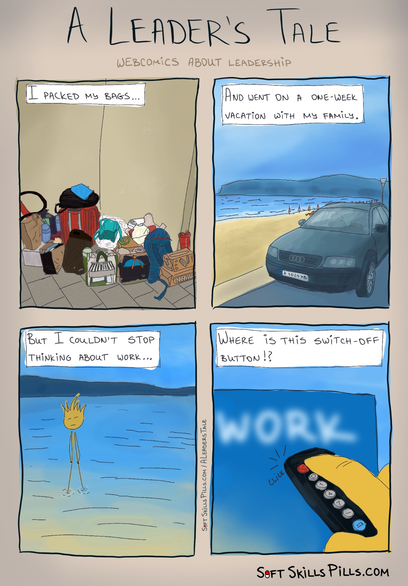

Slide 2
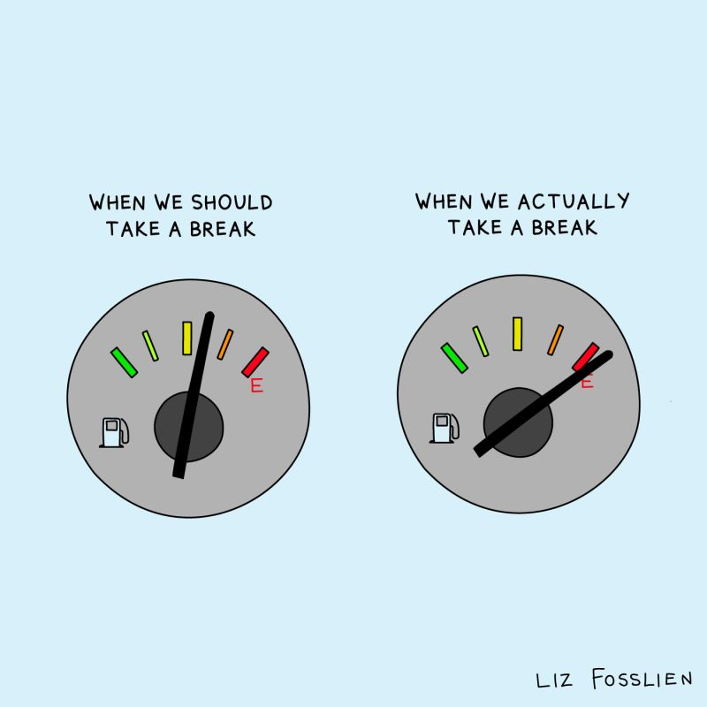

Slide 3
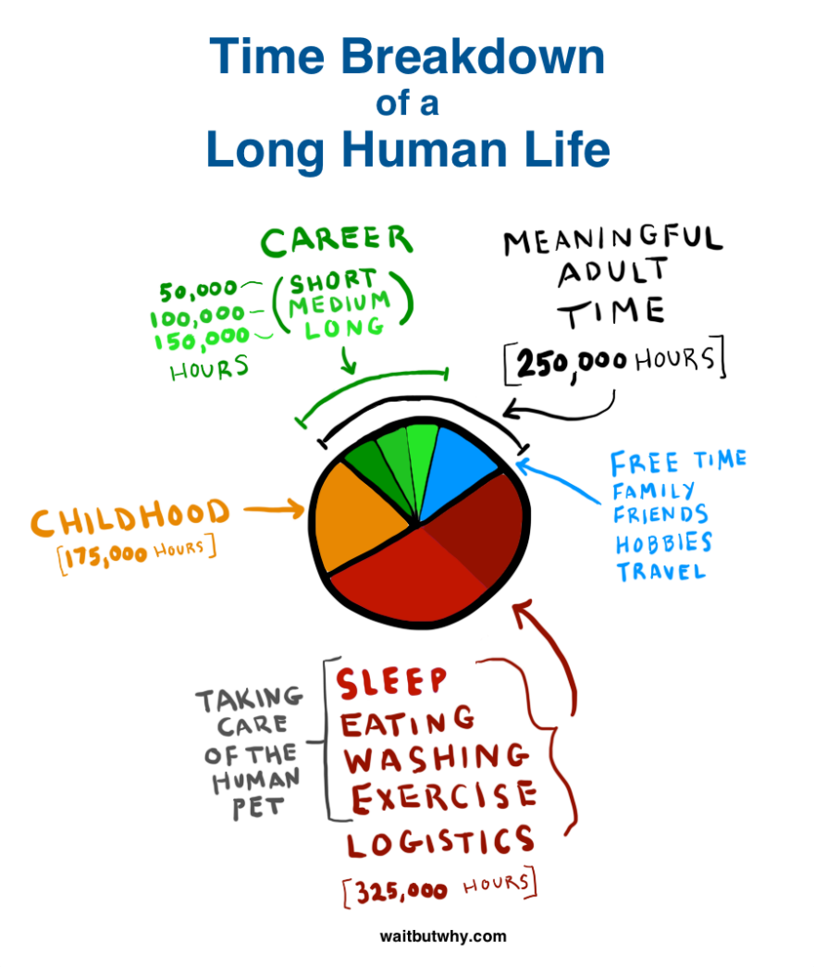

Slide 4
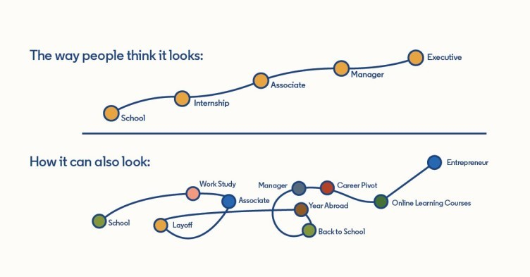

Slide 5

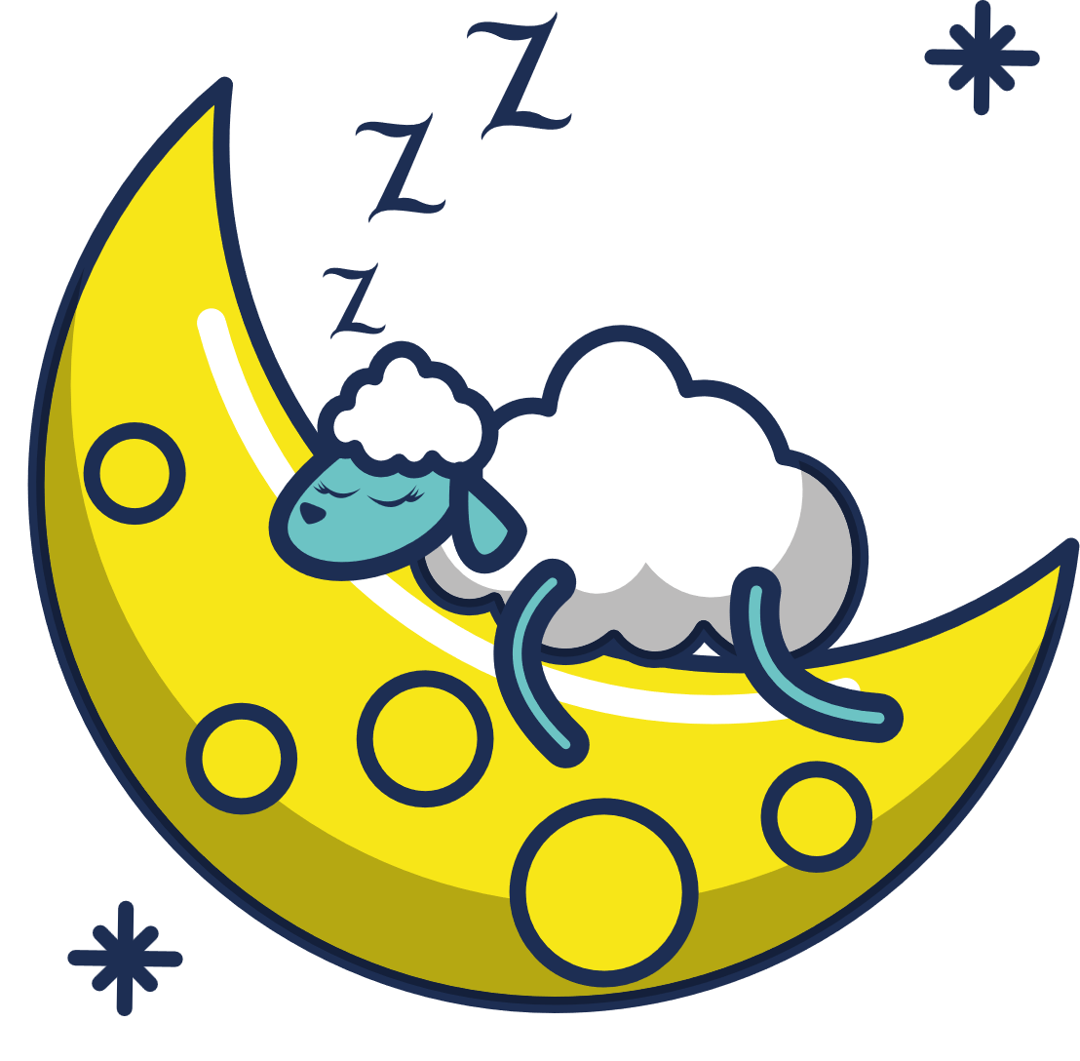





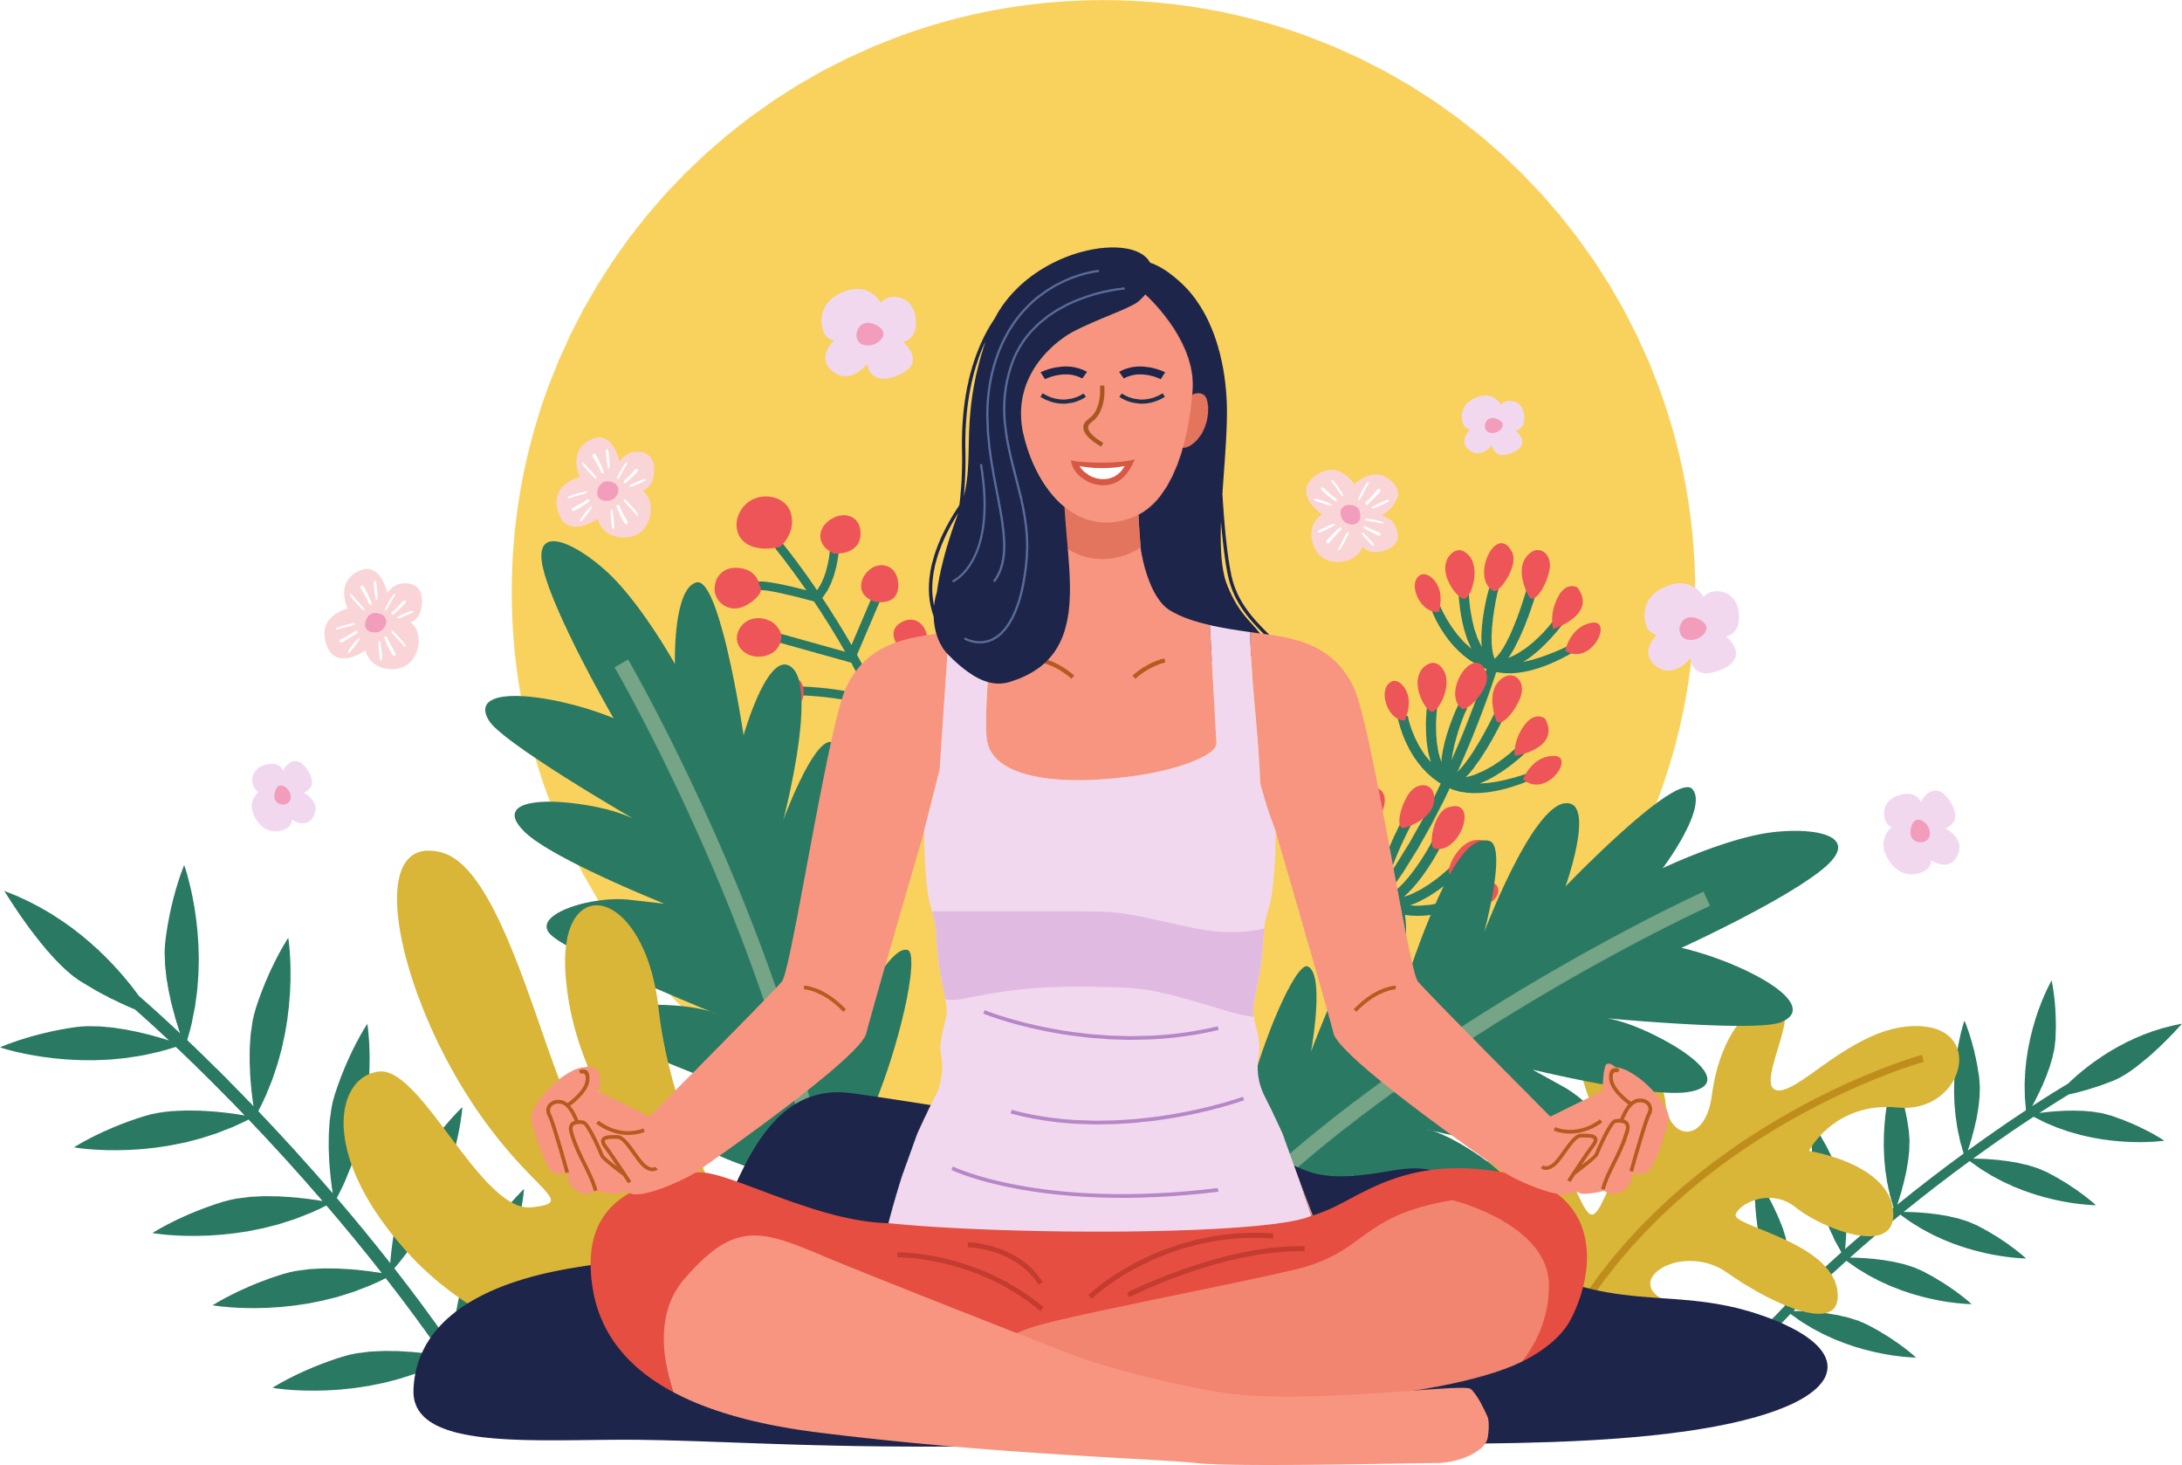





7 types of rest to avoid burnout
Physical Rest
Emotional Rest
Mental Rest
Spiritual Rest
Creative Rest
Sensory Rest
Social Rest

Slide 6
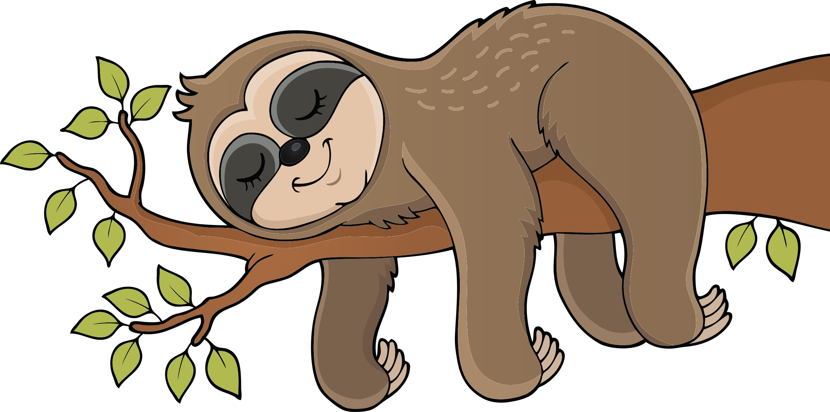
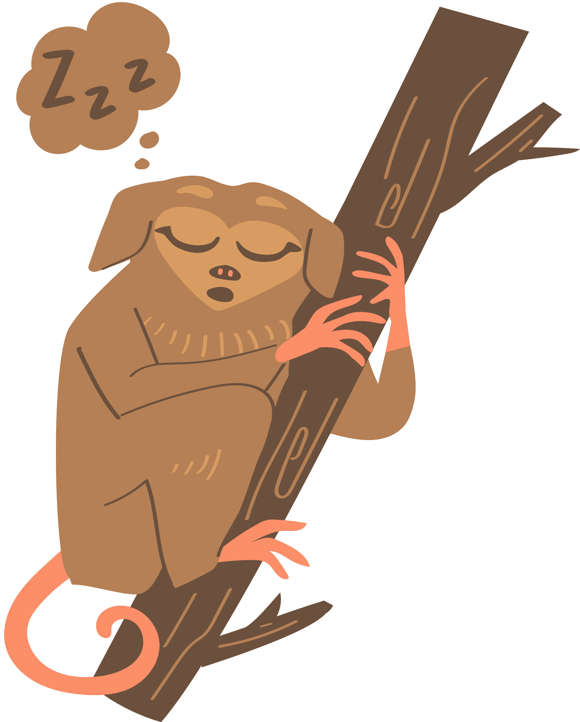


Physical Rest
Lack of sleep and overtraining deplete your body's energy.
Types of physical rest :
Passive and Active
Passive
• Sleep 7+ hrs. nightly
• Take power naps (as needed)
Active
• Stretch
• Massage
• Use an ergonomic setup

Slide 7



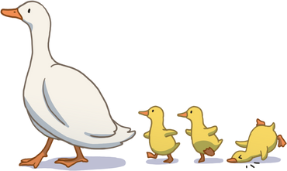
Mental Rest
Mental rest deficit is caused by overtaxing your thinking.
• Write down your to-dos
• Reference checklists (packing, groceries, etc.)
• Create a shutdown ritual to separate work and life
• Take a break from problem-solving
• Brain-breaks
• Music, silence, journaling

Slide 8




Emotional Rest
Emotional rest deficit occurs when you feel like you can't be authentic.
Ex: An airline attendant who must always smile, despite rude passengers.
• Spend time with people you can be authentic around
• Try speaking with a therapist to release emotional labor

Slide 9




Creative Rest
Appreciate beauty in any form, whether natural or human-created:
Natural
• Take in a sunrise or sunset
• Go for a walk in nature
• Be childlike and reawaken wonder
Human-created
• Visit a museum or art festival
• Engage with inspiring music, books, documentaries, etc.

Slide 10
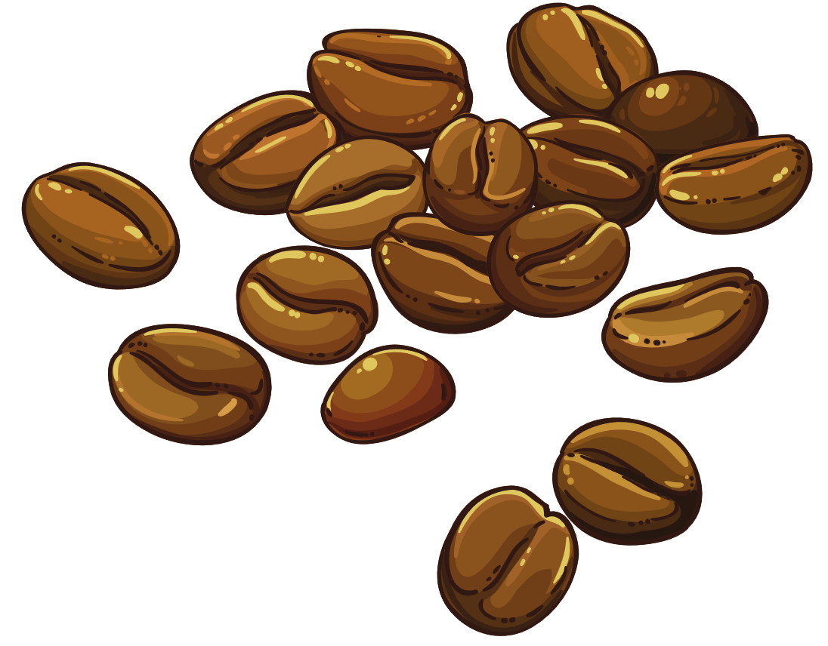
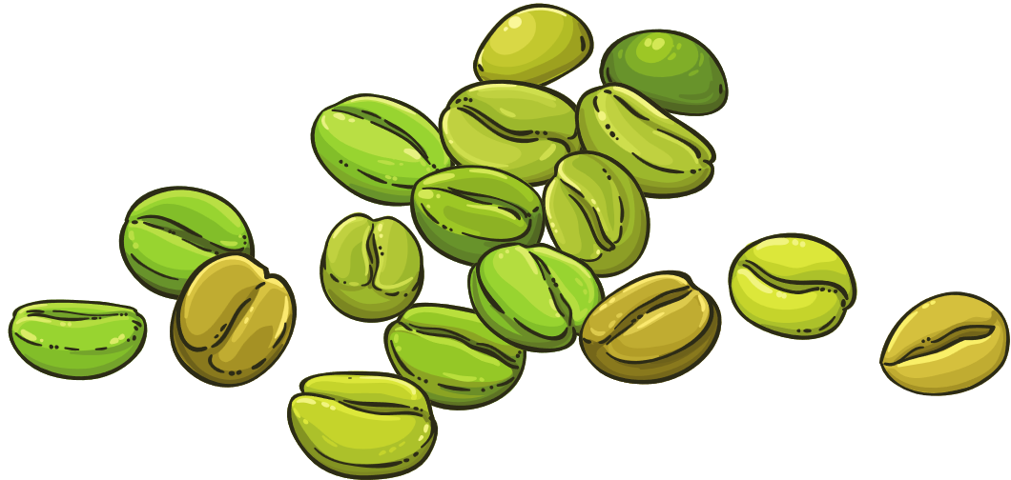



Sensory Rest
The modern individual is overstimulated.
• Take a break from social media
• Turn off notifications (sounds and visual alerts)
• Limit video meetings
• Set a relaxing evening ambiance (soothing music, candles, etc.)
• Turn down lights

Slide 11


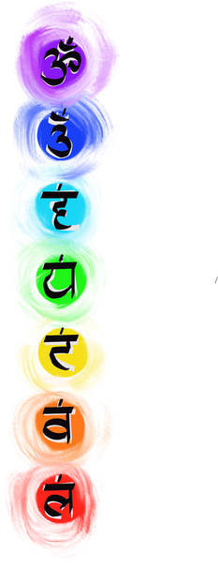

Spiritual Rest
Do things that provide a meaning.
Be part of something bigger than yourself.
• Volunteer
• Work a job that feels purpose-driven
• Participate in faith-based activities (if aligned to your belief system)

Slide 12


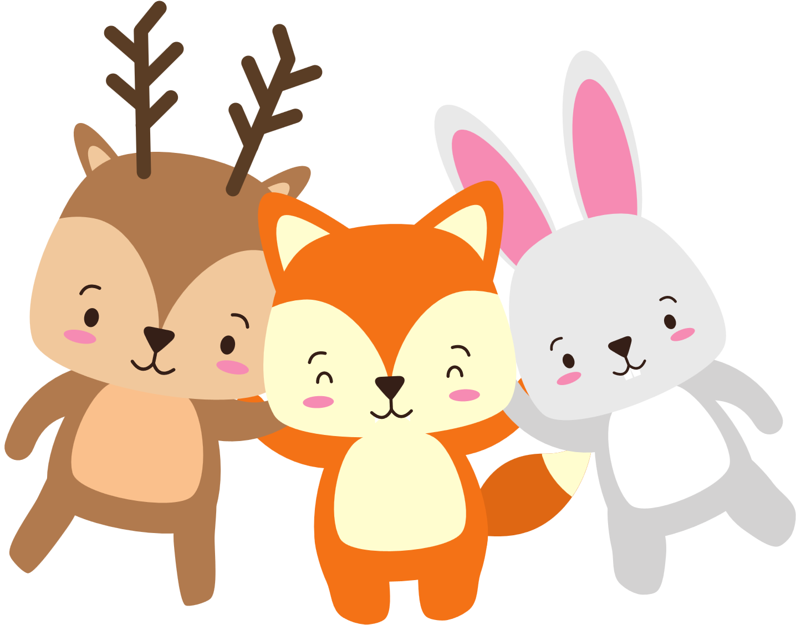

Social Rest
Evaluate your relationships.
• Spend more time with people who give you energy and provide support
• Spend less time with people who steal your energy
• If you're an introvert, block out time to be alone.
• Fill your own battery

Slide 13




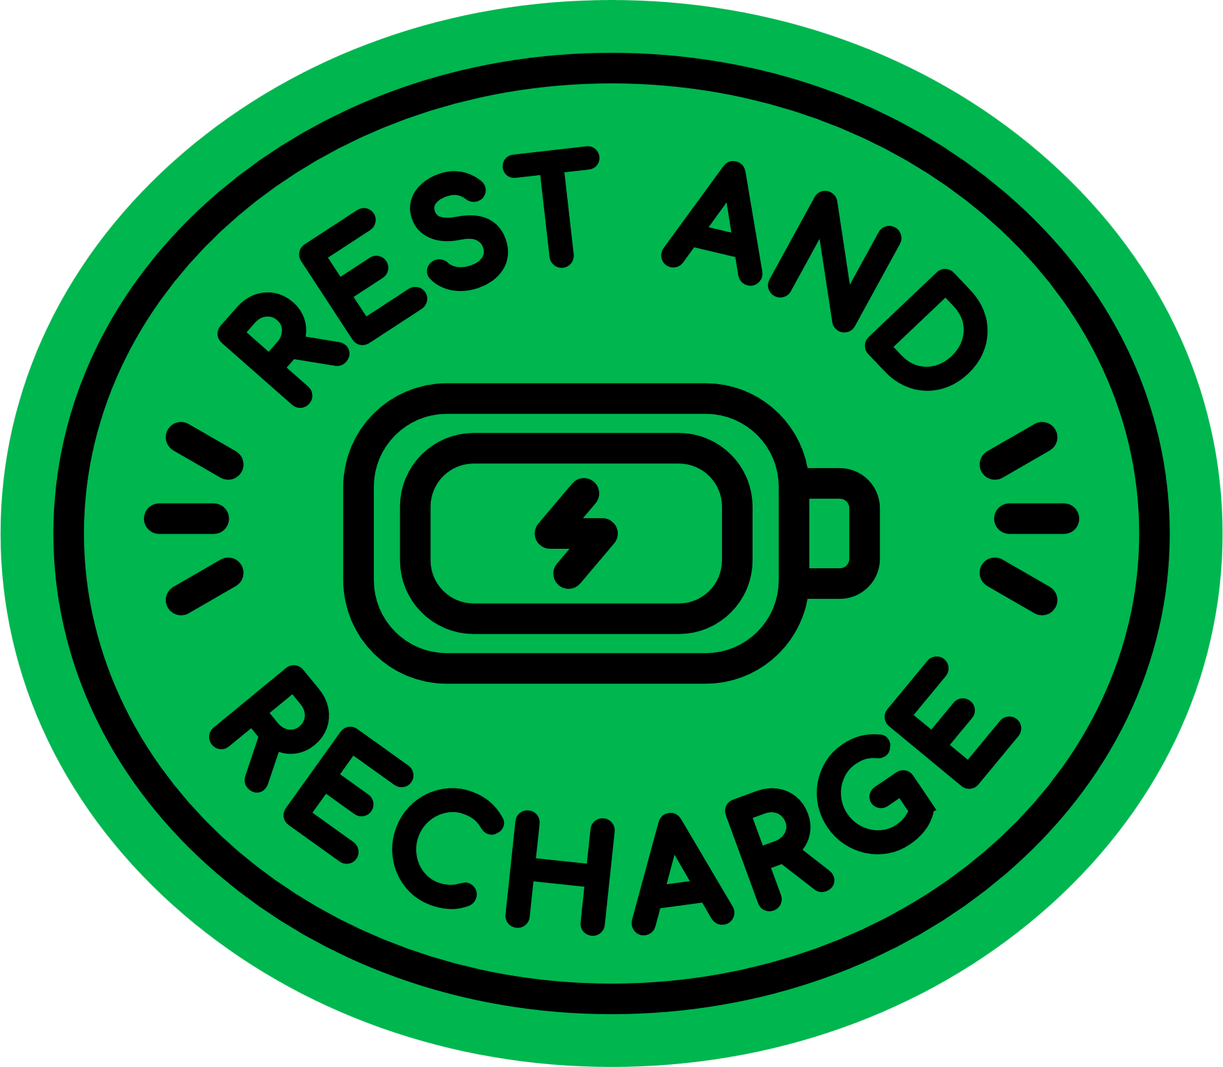


Dr. Dalton-Smith recommends starting with your 1-2 biggest rest deficits
(And not trying to eat the whole elephant at once).
Then, over time, create daily and weekly habits to get all 7.
Made with by Vaishnavi

Slide 14
